Slide 1
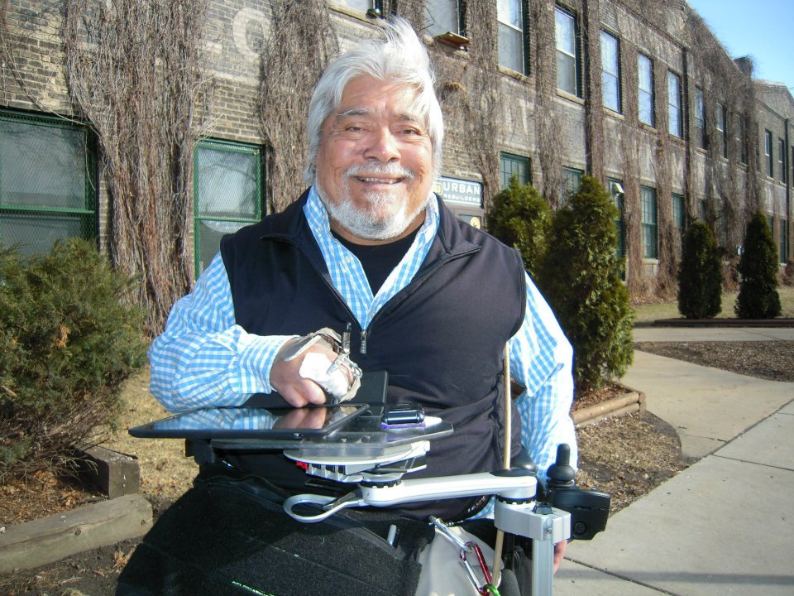
RSCH-17: A Consumer-Centered Approach to Evaluating Assistive Technology Usability
Lynn Gitlow, Ph.D., OTR/L, ATP
Adam Kinney, B.A., MSOTS
Ithaca College
Dianne Goodwin, MEBME
Sarah Chapman
BlueSky Designs, Inc.

Slide 2
Outline
Introduction to the project
Introduction to the Mount’n Mover
Importance of AT outcomes/usability research
Methodology
Results
Discussion and Implications for future research
Research conducted by Ithaca College in collaboration with BlueSky Designs

Slide 3
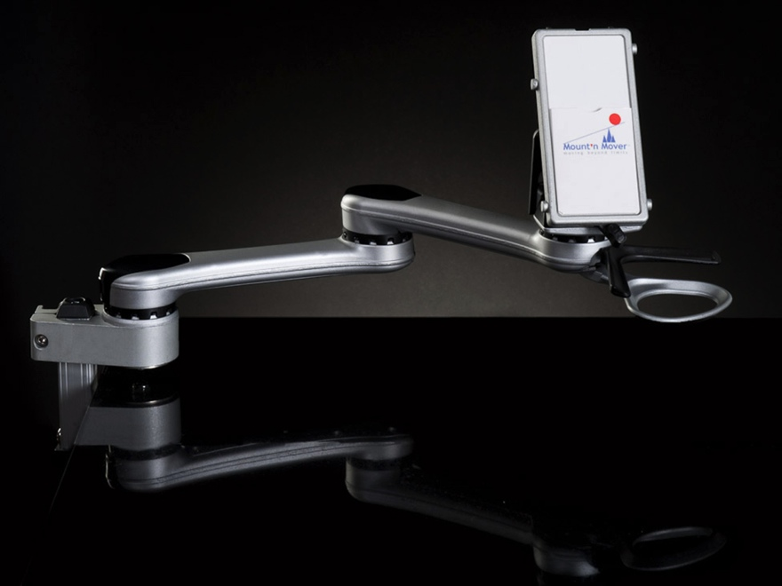
The Mount’n Mover
The Mount’n Mover is a mounting system that attaches to a variety of assistive and general purpose devices
Unique mechanisms allow users to independently manipulate the attached device with great ease and flexibility
Mount'n Mover Overview Video
Notes:
Mary Kay Walch?

Slide 4
Classification of Mount’n Mover as AT
An assistive technology device is defined as “any item, piece of equipment, or product system, whether acquired commercially, modified, or customized, that is used to increase, maintain, or improve functional capabilities of individuals with disabilities” (AT Act of 2004)
Users can attach the mounting system to laptops, cameras, tablets, speech devices, and other products that facilitate active participation in meaningful activities
Users can move these attached devices in a wide range of angles with ease, which allows a user with limited use of their upper extremities to move their device to a position that facilitates independent performance in a variety of activities

Slide 5
The Mount’n Mover in Action

Slide 6
Why Measuring AT Outcomes is Important
Given how important assistive technology is in facilitating independence, it is essential that professionals recommend effective technology (Silver-Pacuilla, Brown, Overton, & Stewart, 2011)
To ensure resources are well spent, the impact of these devices must be documented (Silver-Pacuilla et al., 2011)
The user, the user’s social supports and caregivers, manufacturers and vendors, service providers, third-party payers, rehabilitation scientists, and policy makers all benefit from knowledge of assistive device outcomes (Fuhrer, Jutai, Scherer, & Deruyter, 2003)

Slide 7
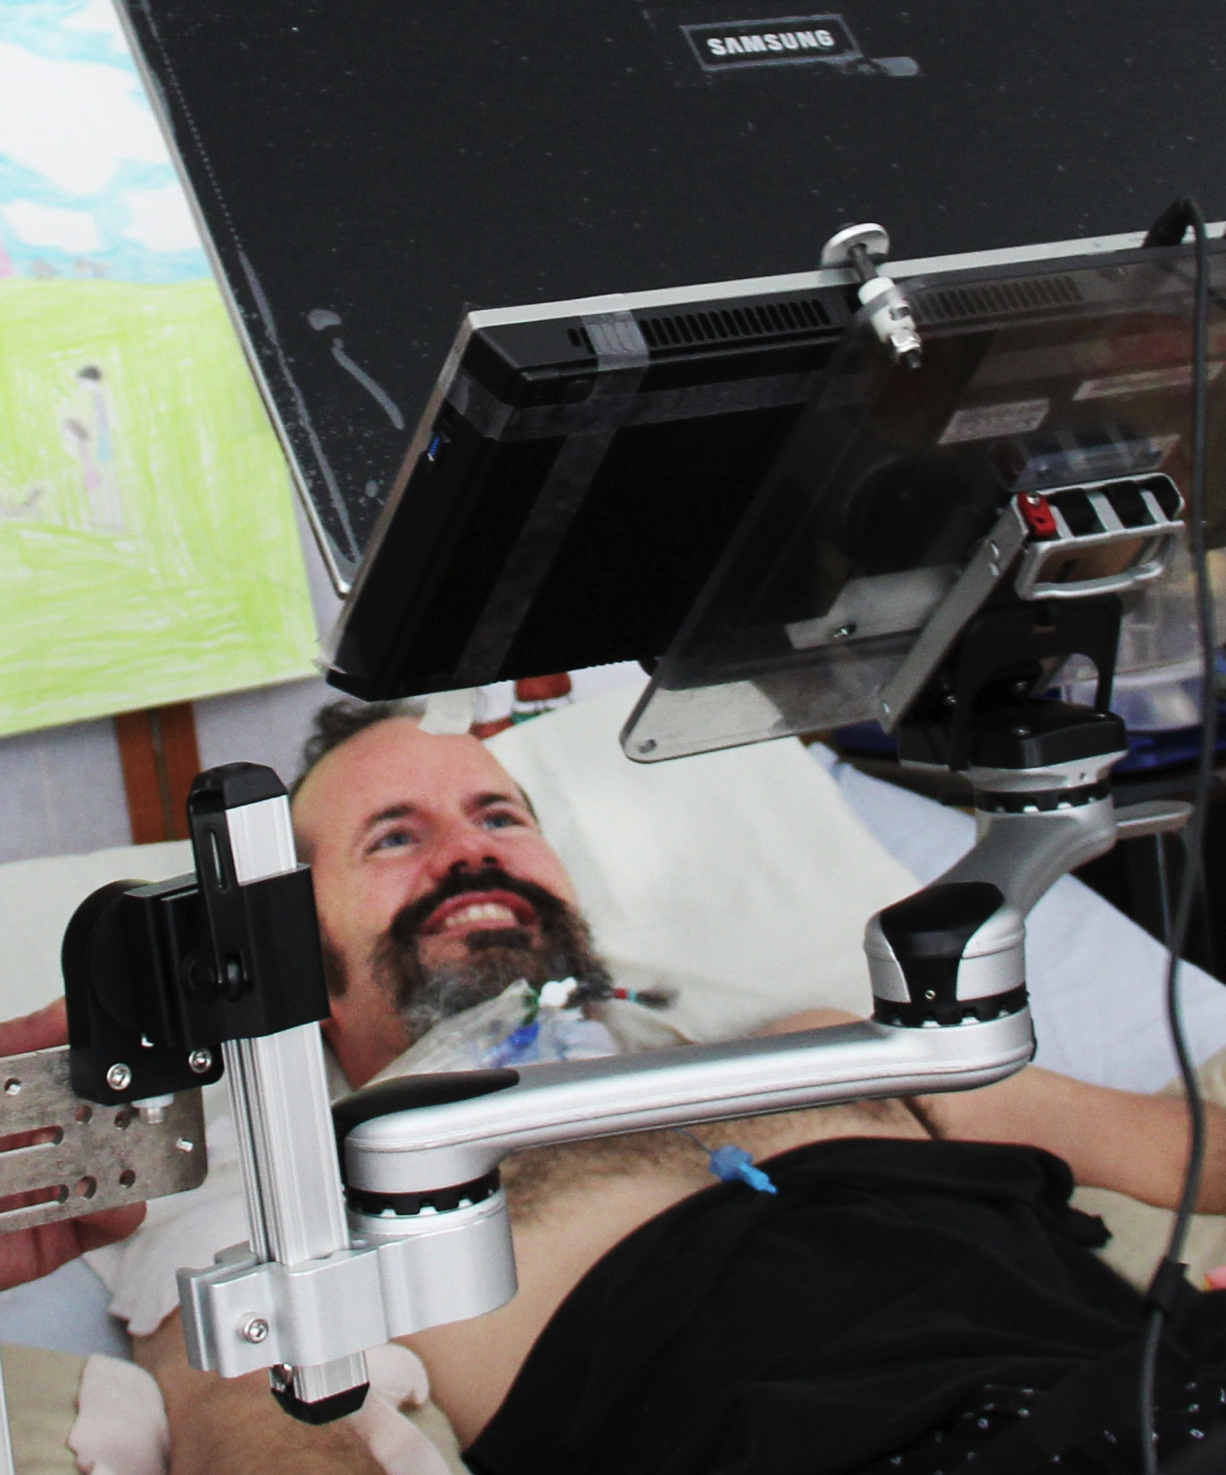
What Determines a Device’s Usability?
Device effectiveness (Arthanat, Bauer, Lenker, Nochajski, & Wu, 2007)
Device efficiency
(Arthanat et al., 2007)
User satisfaction with the device
in increasing one’s ability to
participate in activities within
multiple contexts
(Arthanat et al., 2007)
Notes:
IN TALKING ABOUT THIS WE SHOULD BE ABLE TO DESCRIBE EACH TERM AND THEN MENTION SOMETHING ABOUT increasing participation

Slide 8
Methodology
Retrospective case study design using quantitative assessments of existing users
Administered the Psychosocial Impact of Assistive Devices Scale (PIADS) online using Qualtrics, with the option for the user to participate in a structured interview using the Canadian Occupational Performance Measure (COPM)
The COPM was administered in a variety of ways according to the user’s functional status, including Skype, telephone, and instant message
Study approved by the Ithaca College Human Subjects Review Committee

Slide 9
About the PIADS
The PIADS was used to measure changes in functional independence and psychosocial impact of the intervention
26-item self-report questionnaire designed to assess the effects of an assistive device on functional independence, well-being, and quality of life (Jutai & Day, 2002)
Measures factors intrinsic to the individual as well as environmental factors which impact the psychosocial functioning of the person using the device (Jutai & Day, 2002)

Slide 10
About the COPM
Used to investigate the users’ performance and satisfaction with their performance in meaningful activities before and after use of the mounting device
Individualized standardized instrument that has been used in a number of research studies investigating outcomes of AT and is a reliable and valid measurement tool (Carswell, McColl, Baptiste, Law, Polatajko, & Pollock, 2004)

Slide 11
Sample
A convenience sample of recipients of the Mount’n Mover device were recruited by email to take place in the study
There were 10 total respondents, with 4 consenting to participate in the structured interview

Slide 12
Demographics
Online Survey: 3 females and 7 males
Interview: 1 female and 3 males
6 clients filled out the survey independently, 3 with the help of a caregiver, and one with the help of a therapist
9 are still using the device, while 1 no longer uses the device

Slide 13
General Results
The mount was used for a wide variety of devices including communication devices (n=6), phones (n=2), laptops (n=2), eating trays (n=2), tablets (n=2) and cameras (n=1)
80% of respondents were extremely satisfied with the device and felt that the device was extremely important to their lives
Eight respondents agreed or strongly agreed that they received adequate training and support in use of the device, and two strongly disagreed with this statement
BlueSky Designs noted that the level of direct support varies based on the vendor through which an end user receives the device

Slide 14
PIADS Results
Scale of -3 to +3, where -3 = Greatly decreases and 3 = Greatly increases
Subscale scores are calculated from several responses from the 26 items in the assessment
Subscales include Competence, Adaptability, and Self-Esteem (Jutai & Day, 2002)

Slide 15
PIADS Subscale Results
Subscale | N | Mean | SD
Competence | 9 | 2.121 | 1.049
Adaptability | 9 | 2.147 | 1.046
Self-Esteem | 9 | 2.001 | 1.160
*One user omitted due to missing values in items needed to calculate subscale.
For nine of the ten respondents, their competence, adaptability and self-esteem increased as a result of using the Mount‘n Mover

Slide 16
PIADS Negative Emotion Item Results
Item | N | Mean | SD
Frustration | 10 | -1.40 | 1.350
Embarrassment* | 9 | -1.33 | 1.414
Confusion | 10 | -.90 | 2.079
*One user did not enter response for item
The results indicate that on average, the users’ frustration, embarrassment, and confusion decreased as a result of using the device

Slide 17
COPM Measurements
Importance: 1= not important to me to be able to do this through 10= very important for me to be able to do this
Performance: 1= I am not able to do this through 10= I am able to do this well
Satisfaction: 1 = am not satisfied at all with the way I perform this through 10 = I am very satisfied with the way I perform this
(Carswell et al., 2004)

Slide 18
Scoring Performance and Satisfaction
Performance Score: Total of Performance Scores/# of Problems
Satisfaction Score: Total of Satisfaction Scores/# of Problems
Change in Performance: Performance Score after intervention-Performance Score before intervention
Change in Satisfaction: Satisfaction Score after intervention-Satisfaction Score before intervention
(Carswell et al., 2004)

Slide 19
COPM Results
All four respondents had clinically significant (an increase or decrease of 2) improvement in their performance and satisfaction with performance of meaningful tasks that were impacted by the device
The devices that were used with the Mount’n Mover and the characteristics of the Mount’n Mover enabled users to participate in a variety of meaningful activities including toileting, eating, engaging in volunteer and work-related pursuits, and leisure and social pursuits.

Slide 20
Participant 1
Occupation | Importance | Performance Before | Performance After | Satisfaction Before | Satisfaction After
Transferring | 10 | 3 | 7 | 0 | 10
Using a Ham Radio | 7 | 0 | 10 | 0 | 10
Photography | 10 | 5 | 10 | 6 | 10
Write blog | 10 | 3 | 10 | 3 | 10
Change in Performance Score: 6.5
Change in Satisfaction Score: 7.75
Notes:
21 year old male who had no mounting device prior to receiving the Mount’n Mover

Slide 21
Participant 2
Occupation | Importance | Performance Before | Performance After | Satisfaction Before | Satisfaction After
Transferring | 10 | 6 | 9 | 6 | 10
Answering Technical Calls for AAC Company | 10 | 5 | 8 | 7 | 9
Socializing | 10 | 7 | 9 | 8 | 10
Change in Performance Score: 2.67
Change in Satisfaction Score: 2.67
Notes:
35 year old male who had a mounting device prior to receiving the Mount’n Mover

Slide 22
Participant 3
Occupation | Importance | Performance Before | Performance After | Satisfaction Before | Satisfaction After
Feeding | 10 | 3.5 | 10 | 4 | 10
Community Service | 10 | 4 | 10 | 5 | 10
Photography | 10 | 0 | 10 | 1 | 10
Using Laptop or Tablet | 10 | 0 | 10 | 1 | 10
Going Out to Eat | 10 | 4 | 10 | 4 | 10
Texting | 10 | 4 | 10 | 4 | 10
Change in Performance Score: 7.42
Change in Satisfaction Score: 6.83
Notes:
29 year old male who had a different mounting device prior to receiving the Mount’n Mover
With previous device, he needed someone to position the tray for him before self feeding

Slide 23
Participant 4
Occupation | Importance | Performance Before | Performance After | Satisfaction Before | Satisfaction After
Adaptive Baseball | 10 | 1 | 10 | 1 | 10
Socializing With Friends | 10 | 5 | 10 | 5 | 10
Shopping | 10 | 6 | 10 | 6 | 10
Volunteering | 10 | 5 | 10 | 5 | 10
Using an iPad | 10 | 1 | 10 | 1 | 10
Change in Performance Score: 6.4
Change in Satisfaction Score: 6.4
Notes:
21 year old female who had a mount prior to receiving the Mount’n Mover
Caregiver was giving responses to the survey
Was able to play adapted baseball without removing the mount, could swing it away with ease
Shopping: allowed more comfort because she could move it out of the way, so she was able to tolerate being seated in the chair for extended amounts of time

Slide 24
Limitations
Respondents were recruited from a convenience sample and 90% of respondents continue to use the device, which may indicate that primarily those who were satisfied with the device responded to the study
For interview, respondents were asked to remember performance and satisfaction with performance before they got device and therefore data may not be completely accurate

Slide 25
Discussion
Overall, Mount’n Mover use has positive functional and psychosocial impacts on this sampling of clients using it
Users reported increased effectiveness, efficiency, satisfaction, and increased abilities to participate in meaningful activities when using the device
The versatility and ease of use of the device, as well as training and support, were reported by most users as being important in making devices more useable by them
While the results are not generalizable, they contribute to a growing body of research and can be used in larger studies such as meta-analyses
Additional research following a quasi-experimental design is underway investigating the impact of the device on new users

Slide 26
References
Assistive Technology Act of 2004, Pub. L. 108-364.118 Stat. 1707 (2004). Retrieved March 3, 2013 from GPO Access database http://www.gpo.gov/fdsys/pkg/PLAW- 108publ364/pdf/PLAW-108publ364.pdf.
Fuhrer, M.J., Jutai, J.W., Scherer, M.J., & Deruyter, F. A framework for the conceptual modeling of assistive technology outcomes. Disability and Rehabilitation 2003; 25 (22), 1243-1251.
Silver- Pacuilla, H., Brown, S., Overton, C., & Stewart, A. (2011). Assistive Technology Research Matters. Washington, DC: American Institutes for Research. Retrieved online July 24, 2013 at http://www.nationaltechcenter.org/documents/assistiveTechPrimer.pdf
Arthanat, S., Bauer, S.M., Lenker, J., Nochajski, S., & Wu, Y.. Conceptualization and measurement of assistive technology usability. Disability and Rehabilitation: Assistive Technology 2007; 2(4): 235 – 248.
Gelderblom, G. J. & de Witte, L.P. The assessment of assistive technology outcomes, effects and costs. Technology and Disability 2002; 14: 91–94
Jutai, J., and Day, H. Psychosocial Impact of Assistive Devices Scale (PIADS). Technology and Disability 2002; 14: 91–9.
Carswell, A., McColl, M.A., Baptiste, S., Law, M., Polatajko, H., & Pollock, N. The Canadian occupational performance measure: a research and clinical literature review. Canadian Journal of Occupational Therapy 2004; 71: 210-222.

Slide 27
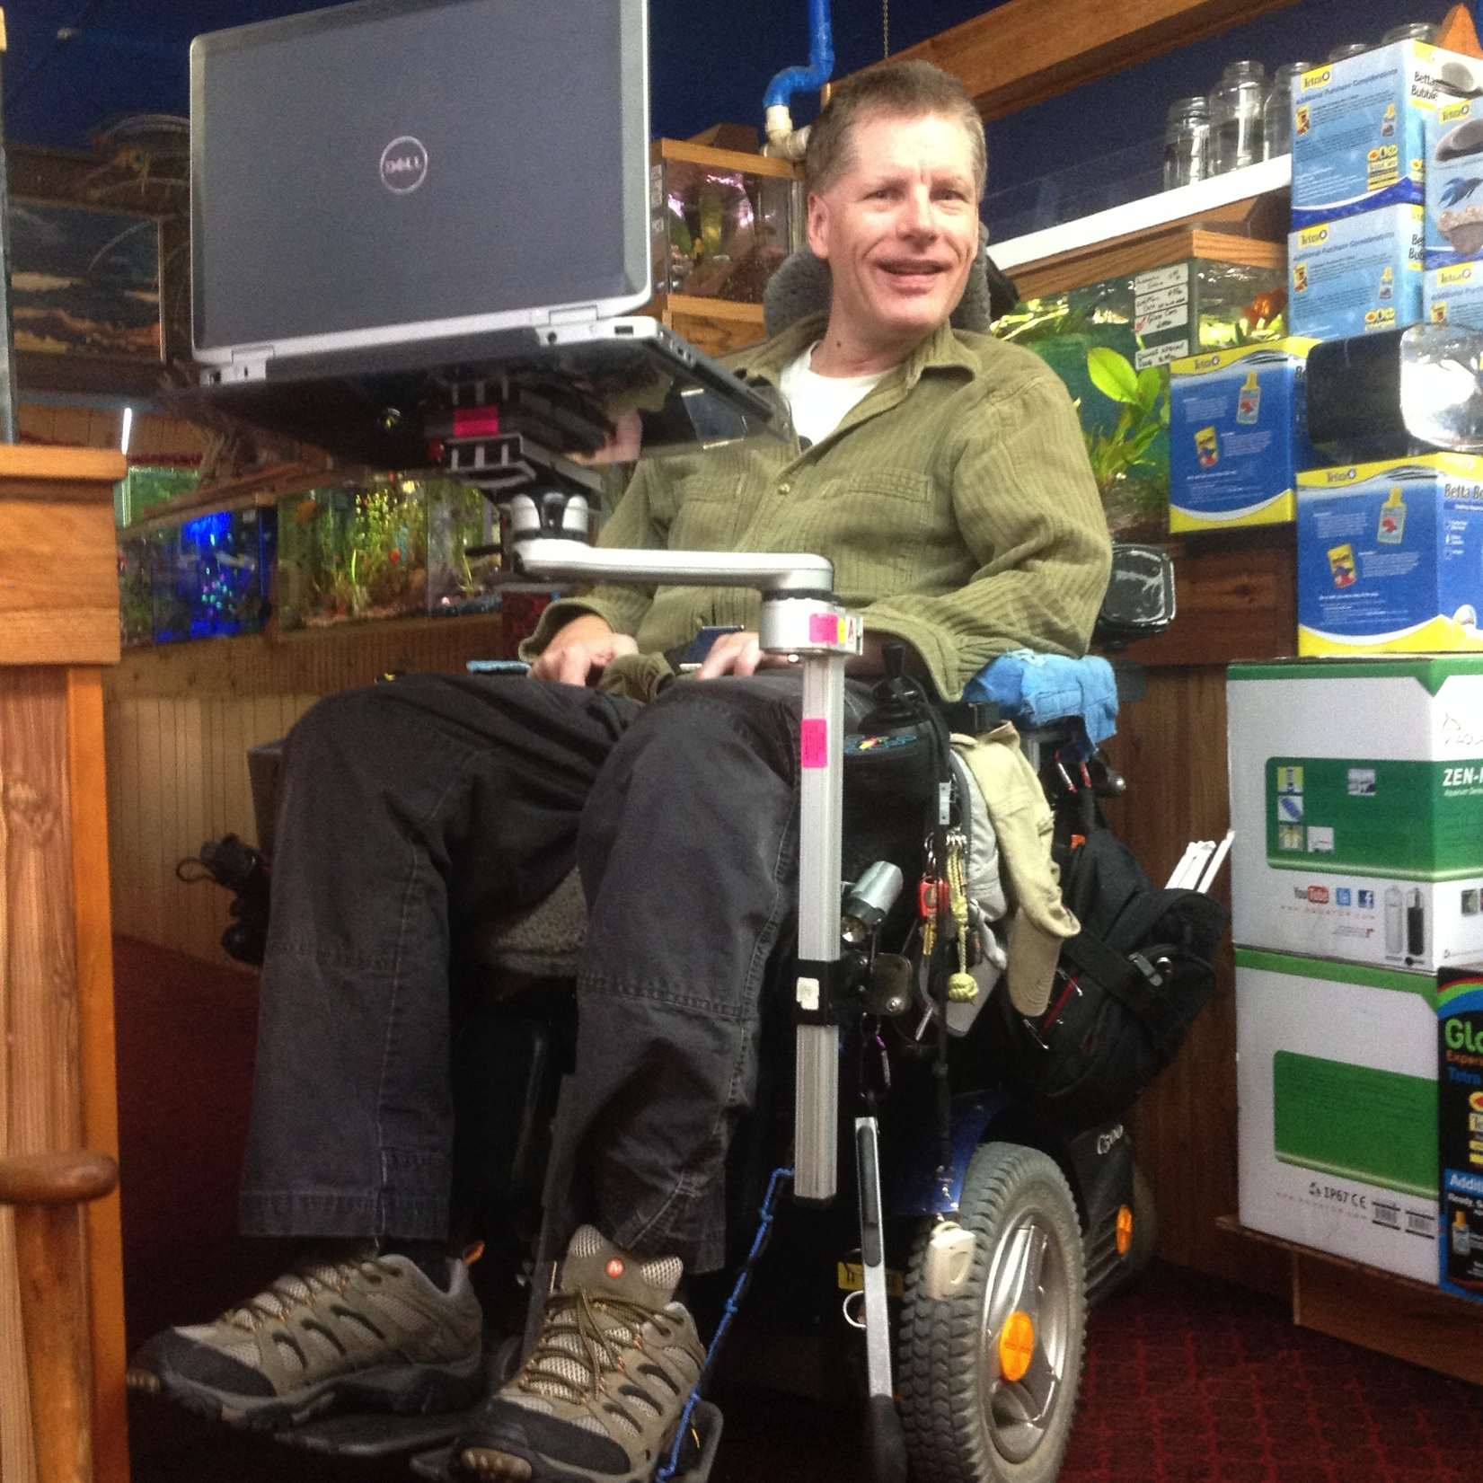
Questions?
Contact:
Ithaca College
Lynn Gitlow, Ph.D., OTR/L, ATP
lgitlow@ithaca.edu
Adam Kinney, B.A., MSOTS
akinney1@ithaca.edu
BlueSky Designs, Inc.
Dianne Goodwin
dianne@blueskydesigns.us
Mary Kay Walch
mkwalch@blueskydesigns.us
Sarah Chapman
sarah@blueskydesigns.us

Slide 28
For More Information
For more information on the Mount’n Mover visit: mountnmover.com
For further information on this study and to view the published version visit:
http://www.mountnmover.com/for-therapists-2/
http://www.mountnmover.com/about-us/papers-and-research/

